Slide 1

Object Detection
Non-max suppression
deeplearning.ai

Slide 2
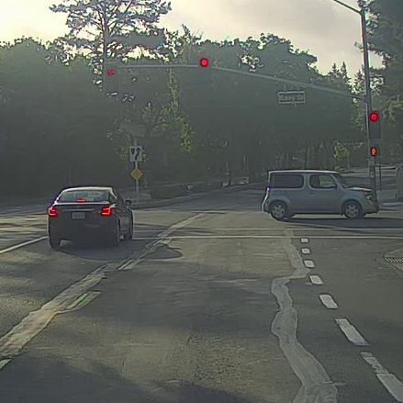
Non-max suppression example

Slide 3
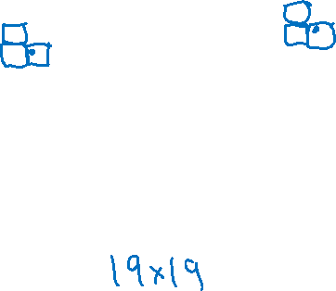
Non-max suppression example
0.6
0.8
0.9
0.3
0.5

Slide 4
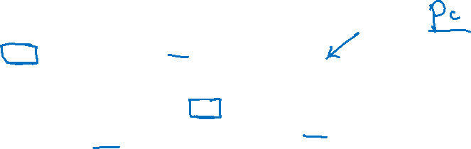
Non-max suppression example
0.6
0.8
0.9
0.7
0.7

Slide 5
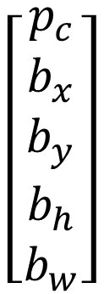
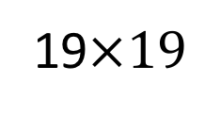
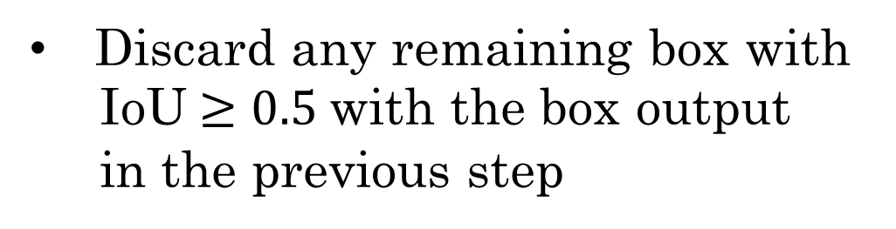
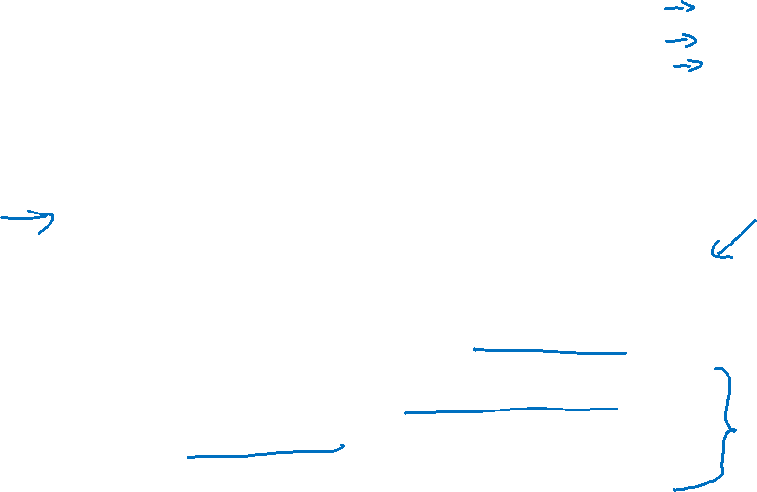
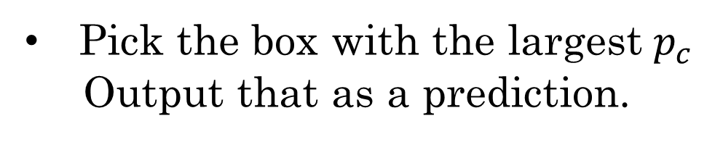
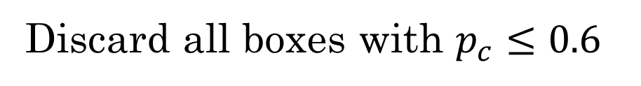
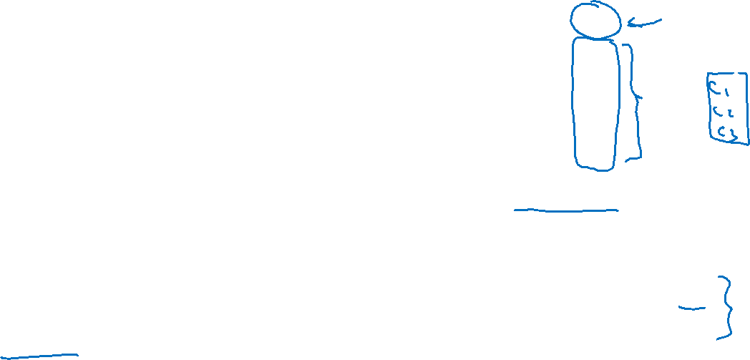
Non-max suppression algorithm
$$\left[\begin{aligned}p_{c} \\ b_{x} \\ b_{y} \\ b_{h} \\ b_{w}\end{aligned}\right]$$
Each output prediction is:
Discard all boxes with $p_{c}≤0.6$
While there are any remaining boxes:
Pick the box with the largest $p_{c}$
Output that as a prediction.
19$×19$
Discard any remaining box with
IoU $≥0.5$with the box output
in the previous step

